Slide 1



Introduction to CLARIN
General presentation to be adapted
Giulia Pedonese
18 Marzo 2024

Slide 2

Sources
This presentation is the result of the adaptation of the following sources:
van der Lek, Iulianna; Fišer, Darja. (2023). Introduction to Language Data: Standards and Repositories. In UPSKILLS Learning Content. https://upskillsproject.eu/project/standards_repositories/. CC BY 4.0.
van der Lek, I., Fišer, D., Samardzic, T., Simonovic, M., Assimakopoulos, S., Bernardini, S., Milicevic Petrovic, M., & Puskas, G. (2023). Integrating research infrastructures into teaching: Recommendations and best practices (Versione 2) https://doi.org/10.5281/zenodo.8114407. CC BY 4.0.
CLARIN ERIC Official Website: https://www.clarin.eu/ . CC BY 2.0

Slide 3
What is CLARIN
CLARIN stands for Common Language Resources and Technology Infrastructure
CLARIN is a distributed digital infrastructure which provides easy and sustainable access to a broad range of language data and tools to support research in the humanities and social sciences and beyond. CLARIN provides access to multimodal digital language data (text, audio, video) and advanced tools with which to explore, analyse or combine these datasets.

Slide 4
What is CLARIN
CLARIN is a network of participating centres all over Europe and further afield, which include universities, research centres, libraries and public archives. Tools and data from different centres are interoperable so that data collections can be combined and tools from different sources can be chained to perform operations at different levels of complexity, regardless of their location.

Slide 5
CLARIN…
Belongs to the Social Sciences and Humanities cluster and an integral part of the European Open Science Cloud
Has the ESFRI ERIC status since 2012, Landmark since 2016
Serves as an ecosystem for knowledge sharing and training
Provides easy and sustainable access for scholars in the humanities and social sciences and beyond to digital language data (in written, spoken or multimodal form); to advanced tools to discover, explore, exploit, annotate, analyse or combine them through a single sign-on environment
Serves as an ecosystem for knowledge sharing and training

Slide 6
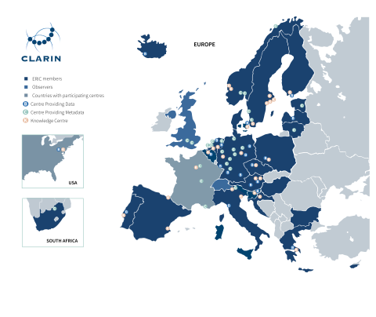
CLARIN TODAY
A distributed network of 72 centres (see the Centre Registry)
24 members: AT, BE, BG, CY, CZ, DK, EE, ES, FI, GR, HR, HU, IS, IT, LT, LV, NL, NO, PL, PT, SE, SI, ZA
2 observers: CH, UK
Third Party: Carnegie Mellon University, USA

Slide 7
CLARIN-IT
CLARIN-IT is the Italian node of CLARIN. Italy became the 16th Full Member of CLARIN ERIC in 2015. The Founding member of the National Consortium is the Institute for Computational Linguistics “Antonio Zampolli” of the National Research Council of Italy.
CLARIN is involved in the H2IOSC project through its Italian national consortium CLARIN-IT.

Slide 8
CLARIN-IT
The Italian CLARIN Consortium includes the following centres:
The ILC4CLARIN Centre at the Institute for Computational Linguistics “Antonio Zampolli” in Pisa. It is officially recognized as a CLARIN Service Providing Centre (CLARIN Centre of Type B)
EURAC Research CLARIN Centre (ERCC) at the EURAC Research Association in Bolzano, which is a CLARIN Metadata Providing Centre (CLARIN Centre of Type C)
The Knowledge Centre for Computer-Mediated Communication and Social Media Corpora (CKCMC), which is a CLARIN Centre of Tipe K, providing knowledge and expertise on one or more aspects of the domain covered by the CLARIN infrastructure, as well as the
The CLARIN Knowledge Centre for Digital and Public Textual Schholarship (DiPText)

Slide 9
The H2IOSC project
The H2IOSC project aims at creating a federated and inclusive cluster of RIs in the ESFRI domain of Social and Cultural Innovation to allow researchers from various disciplines in the Humanities, Language technologies and the Cultural Heritage sectors collaborate in data and compute intensive research. It encompasses the Italian nodes of four Research Infrastructures:
CLARIN, https://www.clarin.eu/
DARIAH, Digital Research Infrastructure for the Arts and Humanities
E-RHIS, European Research Infrastructure for Heritage Science
OPERAS, Open Scholarly Communication in the European Research Area for SSH

Slide 10
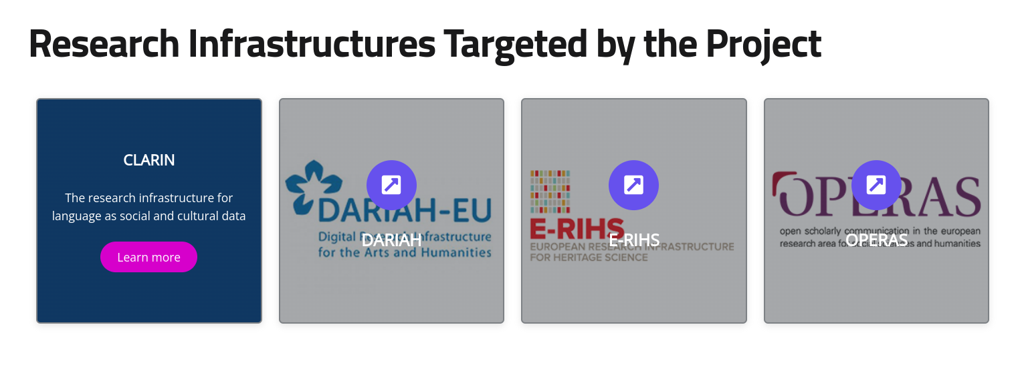
The H2IOSC project

Slide 11
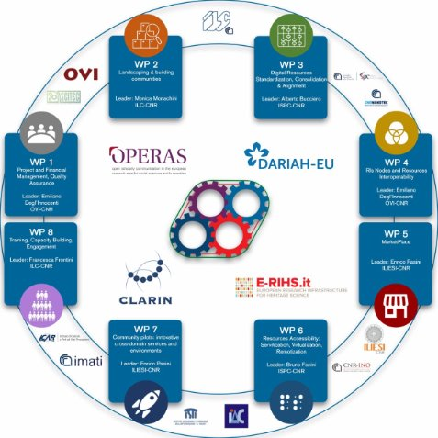
CLARIN for H2IOSC
WP8 - Training, Capacity Building ​​
Engagement​​
Training Infrastructure​​
Shared Methodology
FAIR Training Materials
Train the Trainers​ perspective

Slide 12
CLARIN Core Services
Depositing services to make sure that language resources can be archived and made available to the community in a reliable manner and to help researchers to store their resources in a sustainable way
The Virtual Language Observatory provides an easy-to-use interface, allowing for a uniform search and discovery process for many resources from a wide variety of domains.
The Federated Content Search is a search engine that connects to the local data collections that are available in the centres
The Language Resource Switchboard helps users to find a matching language processing web application for your data
The Virtual Collection Registry provides a registry where scholars can create and publish their virtual collections

Slide 13
How to access CLARIN services
All users can freely explore the CLARIN core services to search for language resources and expertise. Due to license restrictions, some resources are only available for academic users and login is required using your institutional credentials or CLARIN credentials
Academic users in all participating countries can access and use the language resources available in CLARIN data centres with a single sign-on access through the CLARIN Service Provider Federation using their institutional credentials

Slide 14
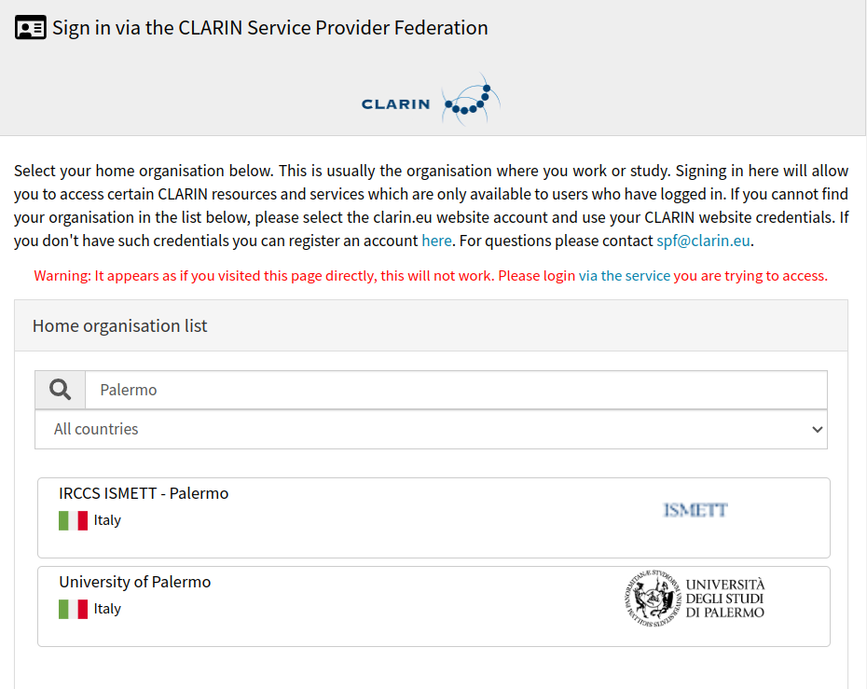
Sign In via the CLARIN Service Provider Federation

Slide 15
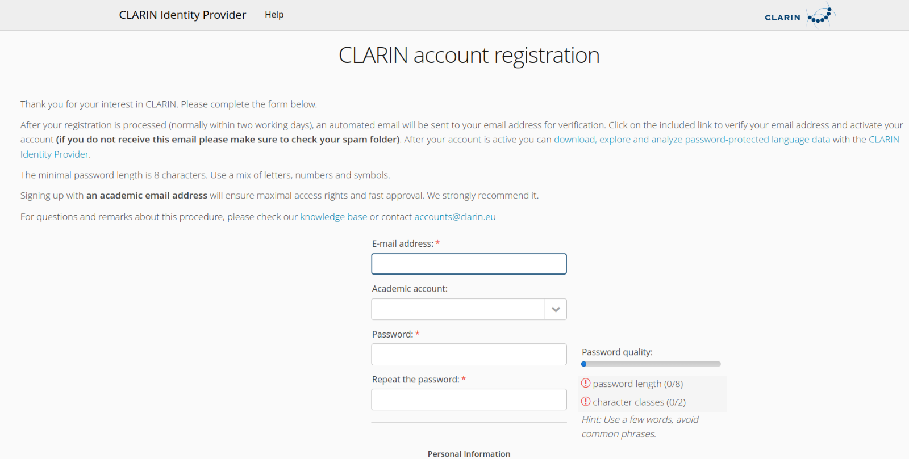
CLARIN Account Registration

Slide 16
Depositing Services
Many of the CLARIN centres offer a depositing service. They are willing to store the resources in their repository and assist with the technical and organisational details. This service ensures many advantages:
Long-term archiving: a storage guarantee can be given for a long period
Resources can be cited easily with a persistent identifier
The resources and their metadata will be integrated into the infrastructure, making it possible to search them efficiently
Password-protected resources can be made available via an institutional login
Once resources are integrated in the CLARIN infrastructure, they can be analysed and enriched more easily with various linguistic tools

Slide 17
Depositing Services
To deposit a resource in CLARIN:
Search for a repository that addresses the data of interest in the Depositing Services catalogue
Check for data compatibility in the CLARIN Standards Information System
Contact the Type B centre hosting the repository to prepare the data
Follow the procedure described in the repository guideline

Slide 18
ILC4CLARIN
ILC4CLARIN is CLARIN-IT B-centre hosted at Institute for Computational Linguistics, National Research Council, in Pisa. It offers depositing services for language datasets and tools for research, especially for Italian and classical languages via its repository
The ILC4CLARIN repository is a disciplinary repository certified by CoreTrust Seal and it offers advanced services to explore the language resources and their metadata (e.g. VLO, Switchboard ecc.)

Slide 19
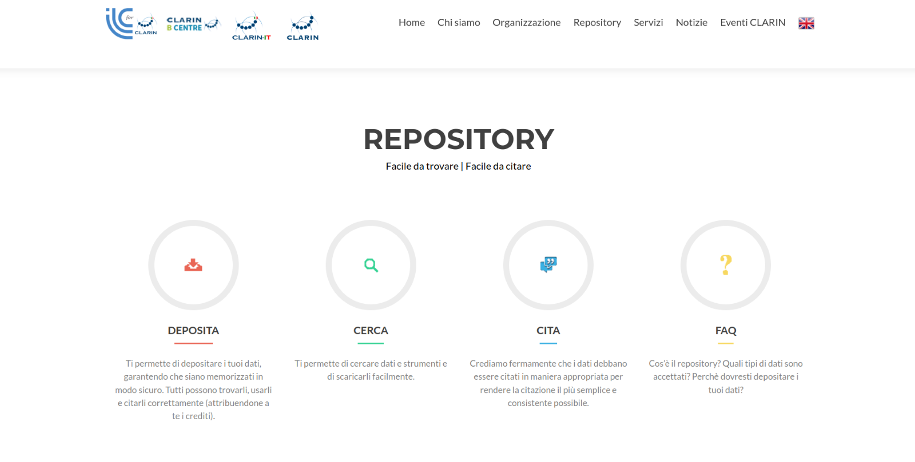
ILC4CLARIN Repository

Slide 20
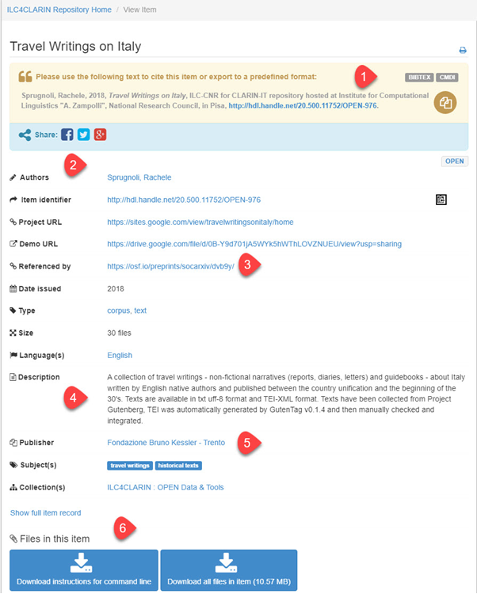
Example of a Corpus in ILC4CLARIN
Citation information via handle​
Metadata fields describing the corpus​
The corpus is referenced in a journal​
The corpus is described, e.g. texts available in UTF-8 format and TEI-XML format​
Publisher information​
Download instructions​

Slide 21
Finding Published Language Resources
The Virtual Language Observatory
A catalogue that harvests metadata about language resources available in distributed repositories
It does not contain language resources; it just helps you locate it via persistent identifiers
Even if a resource has restricted access, the metadata is always freely accessible
It uses faceted search to narrow down your searches

Slide 22
Searching Across Text Collections
Federated Content Search
A search engine to locate specific linguistic patterns across several text collections
The data itself stays at the Centre where it is hosted
It can be used as a first step to discover where interesting resources are hosted
It is not possible to rank the search results, but they can be downloaded in a variety of formats and perform further analysis in other tools

Slide 23
Federated Content Search
How to use it:
Select the language and the query language (CQL)
Specify the collections and the number of hits to be displayed
View the search results as Key Word in Context
Download the results in different file formats

Slide 24
Finding and Querying Corpora
Resource Families
Well-curated corpora and lexical resources organised per data type and language
NLP tools
Licence information
They can be downloaded directly
Some corpora is available via concordancers, e.g. Korp, Corpuscle, or KonText

Slide 25
Finding a Language Processing Tool
Language Resource Switchboard
A central service that you can use to upload a text or a URL and find a matching web-based tool to analyse, visualise, or translate.
It can be accessed from other research data repositories and services, e.g. VLO, Virtual Collection Registry, ARCHE, DARIAH-DE Repository, PARTHENOS VRE, and TextGrid

Slide 26
Using Published Language Resources and Tools
Virtual Collection Registry
Collect the datasets discovered (via the VLO) into a virtual collection
A virtual collection may contain links to datasets, tutorials, reference documents on a topic
You can cite and share the virtual collections with others
The text collections can be downloaded or processed with a matching Switchboard tool

Slide 27
CLARIN Knowledge Infrastructure
Knowledge infrastructure: A set of measures and structures designed to ensure a continuous transfer of knowledge among all actors involved in the construction, operation and use of the infrastructure
Browse the Knowledge Centres alphabetically or by specialization (some categories are already highlighted
Access the Tour de CLARIN For in-depth discussion of UI initiatives and network activities

Slide 28
Stay updated
CLARIN Newsflash
Monthly update on the activities of national consortia
CLARIN Café
Informal and interactive webinars to discuss topics of interest

Slide 29
Thank you!
Contact us
Email@address.it
Email@address.it

